Slide 1


TRAVEL CHATBOT USING CHATGPT
ENHANCING TRAVEL ASSISTANCE THROUGH AI
By: Jhalak Surve
NUID: 002748800

Slide 2



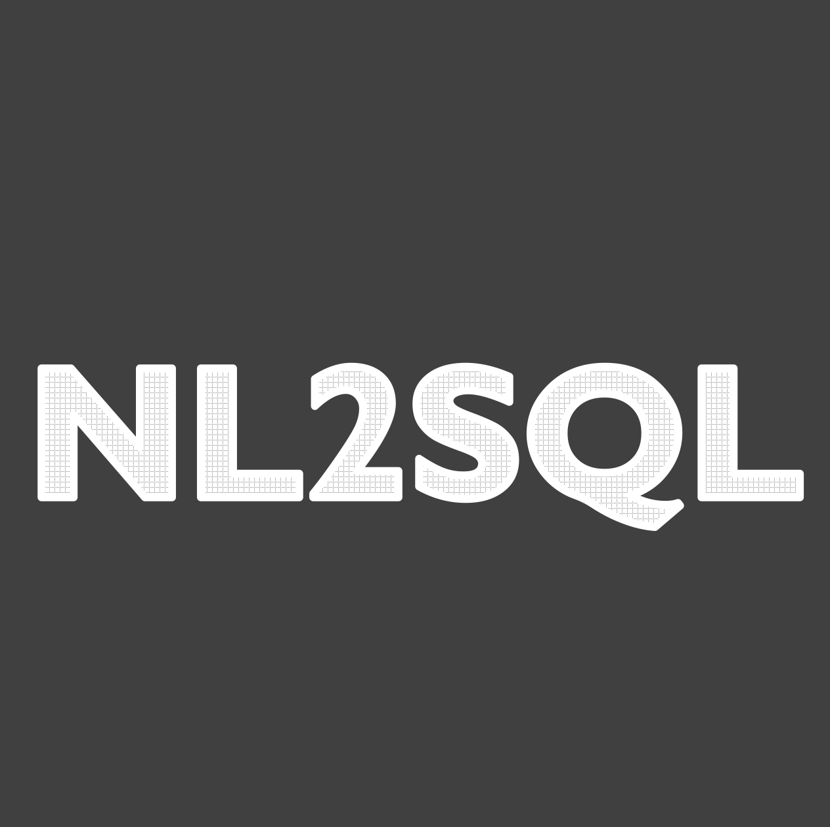
PROJECT OVERVIEW
Integrated OpenAI's GPT-3.5 for dynamic and context-aware responses, improving the user experience.
Developed a Travel Chatbot using Django and React to assist users with travel-related queries.
Implemented NL SQL for
interpreting user intents,
enhancing the bot’s ability to understand and respond effectively.

Slide 3

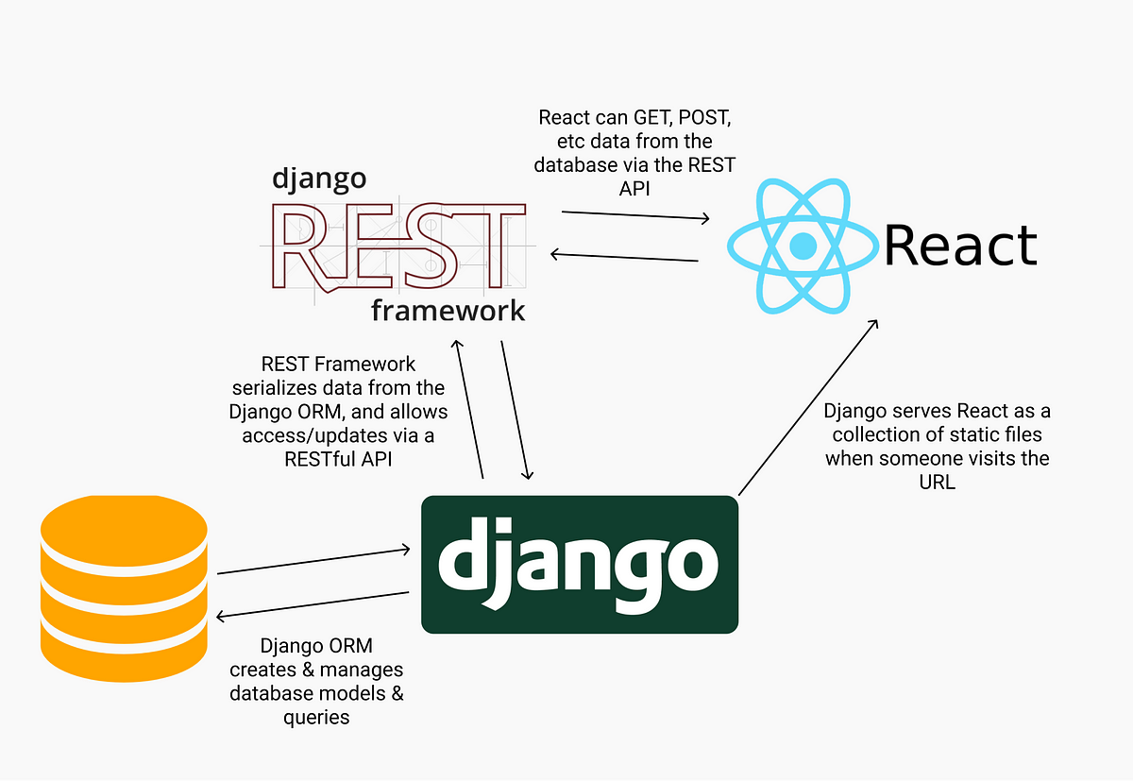

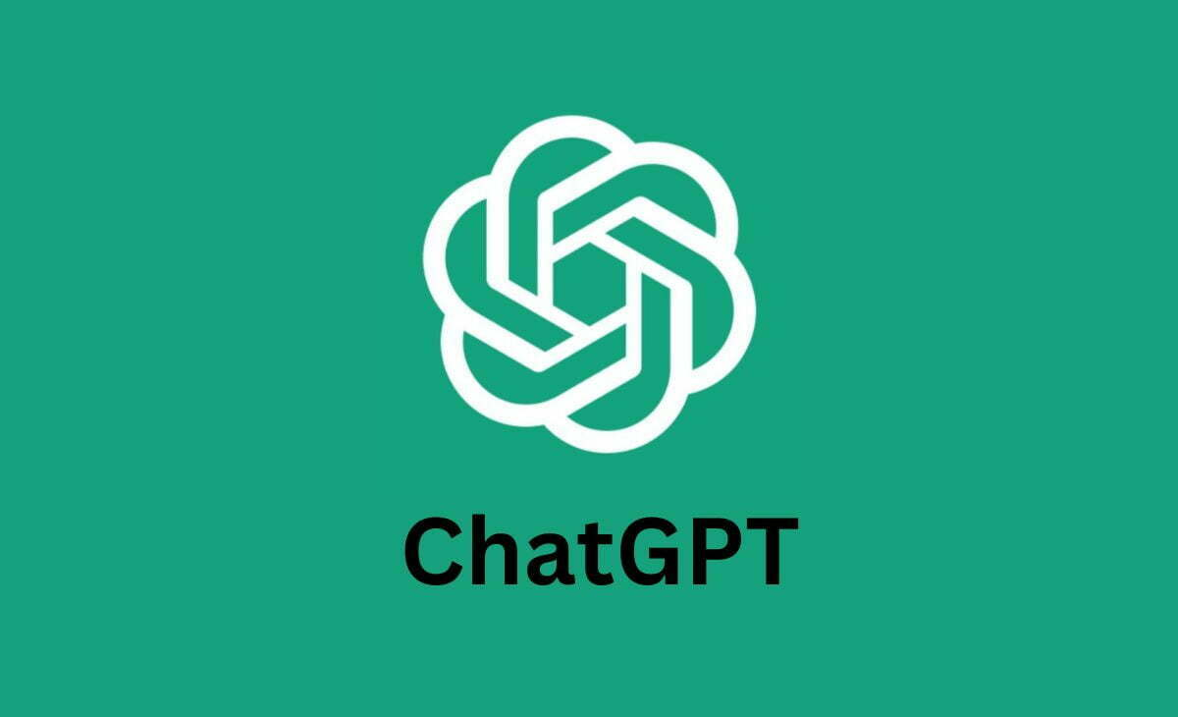
ARCHITECTURE DIAGRAM
Language Processing
MySQL
Database for
querying

Slide 4

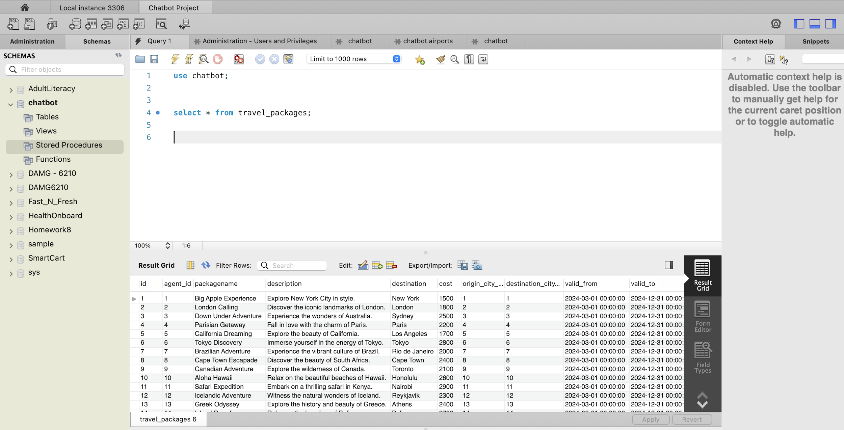
Travel Agent Database

Slide 5

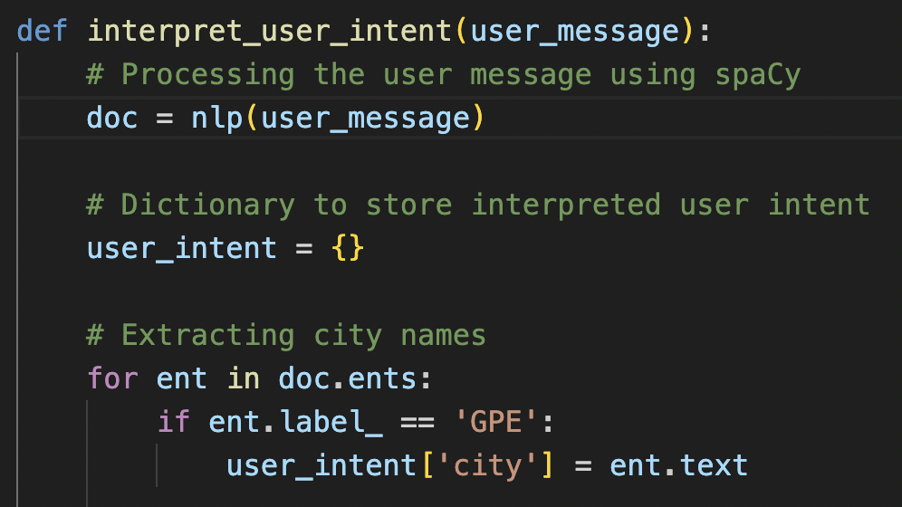
NL SQL INTEGRATION
Utilizes NLP algorithms to comprehend user queries and extract meaningful intents from unstructured text.
Translates interpreted user intents into SQL queries to retrieve relevant data from the database.
Facilitates seamless interaction with the database management system (DBMS) to execute SQL queries.
Enables efficient and accurate query processing by combining the power of NLP for understanding user queries and SQL for database interaction.

Slide 6
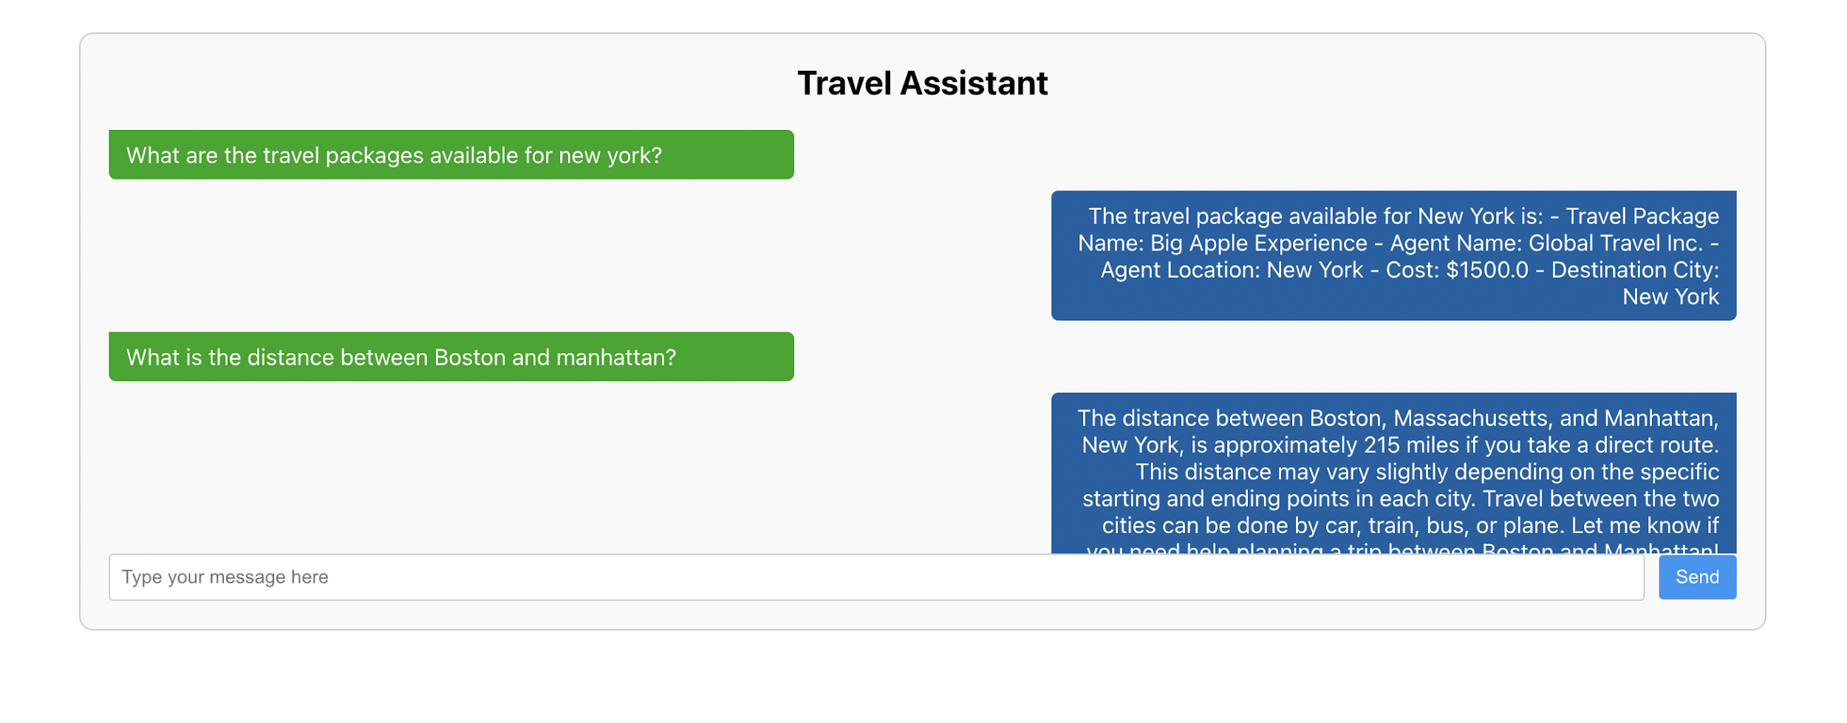
RESULTS
Demonstrated the effectiveness of the system in understanding and addressing user intents accurately.
Achieved accurate responses for user queries

Slide 7
CHALLENGES AND SOLUTIONS
Faced difficulties in refining natural language processing (NLP) to accurately interpret user queries.
Implemented creative strategies to address language ambiguities and optimize NLP performance.

Slide 8
FUTURE ENHANCEMENTS
Exploring additional features such as real-time travel updates to provide users with the latest information on flights, accommodations, and destinations.
Considering user feedback for continuous improvement, including implementing personalized recommendations and refining the user experience based on user interactions.

Slide 9

THANK YOU!

